Slide 1
Progres 3 – Adjoint simulation
Azhar Harisandi - 22320011
Faculty of Mining and Petroleum Engineering
Department of Geophysical Engineering

Slide 2
Gradient-based optimization
Adjoint simulation -> tools untuk menghitung gradien dari misfit function
Data
Fungsi misfit
misfit
model
Forward operator
Sintetik
d(misfit)/d(model)
Model update (model + step vector)
Step direction
Step length

Slide 3
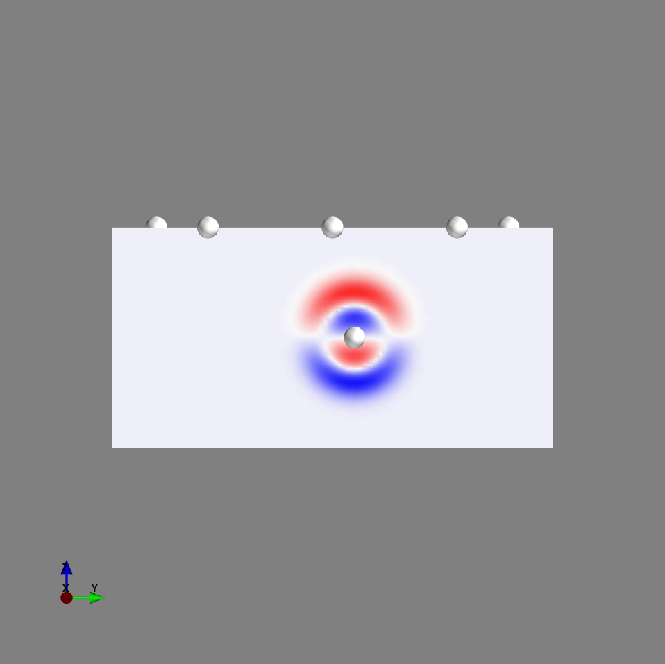
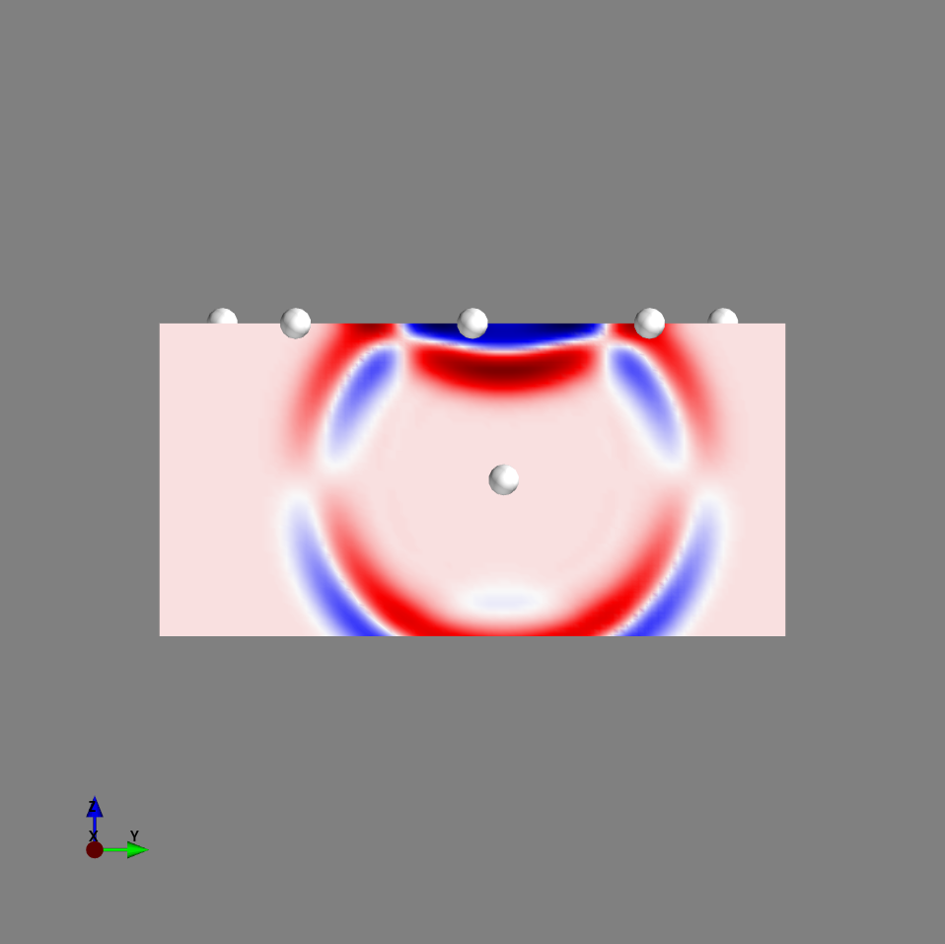
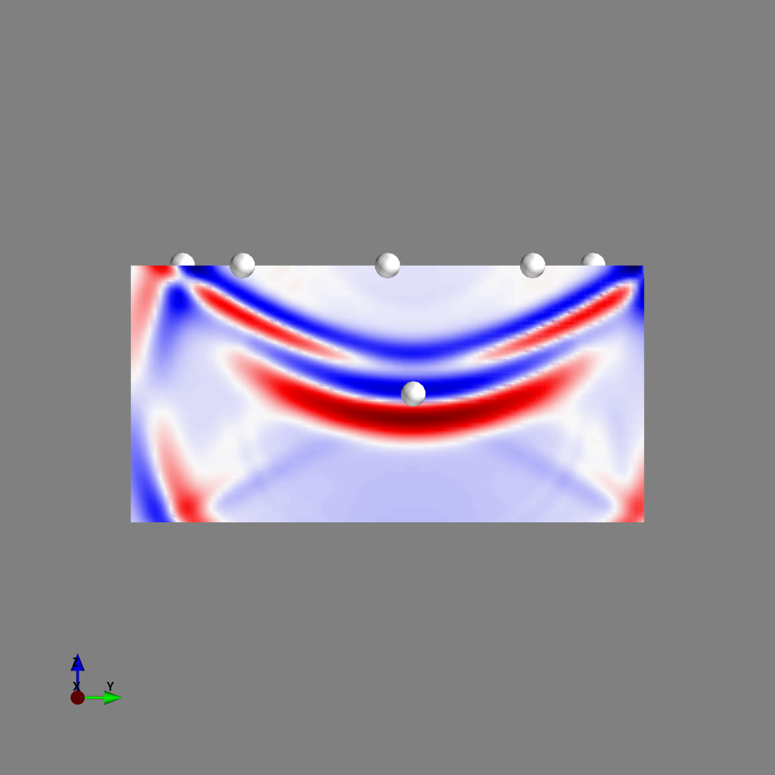
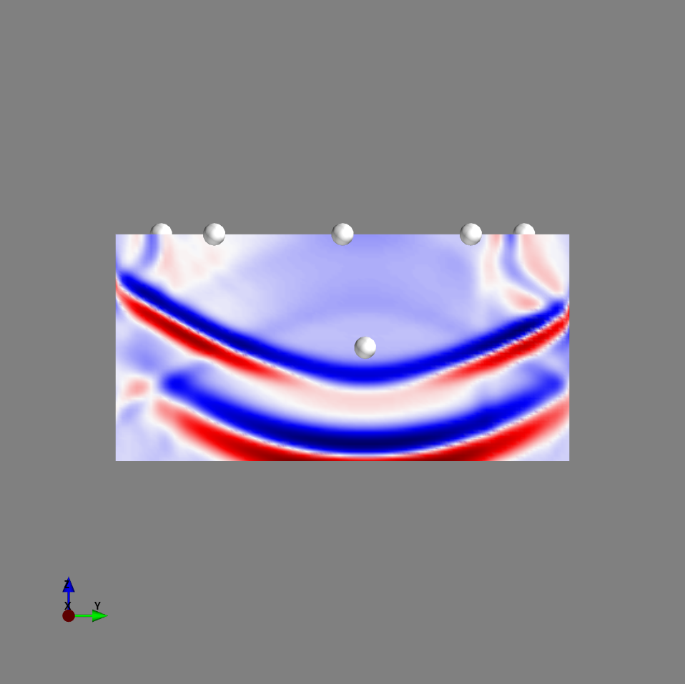
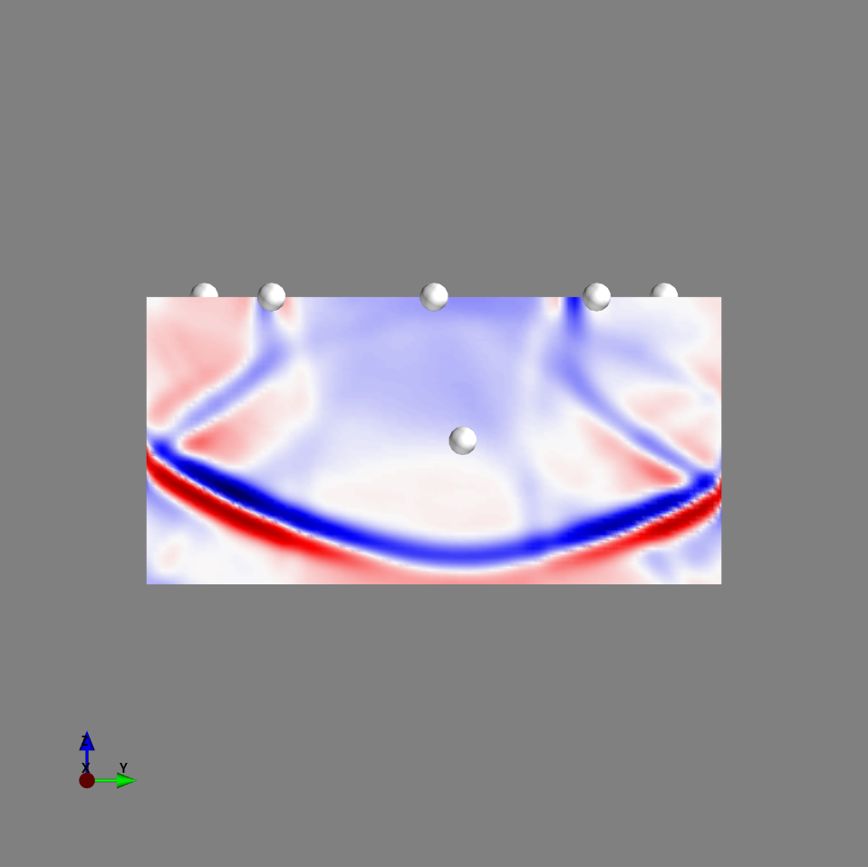
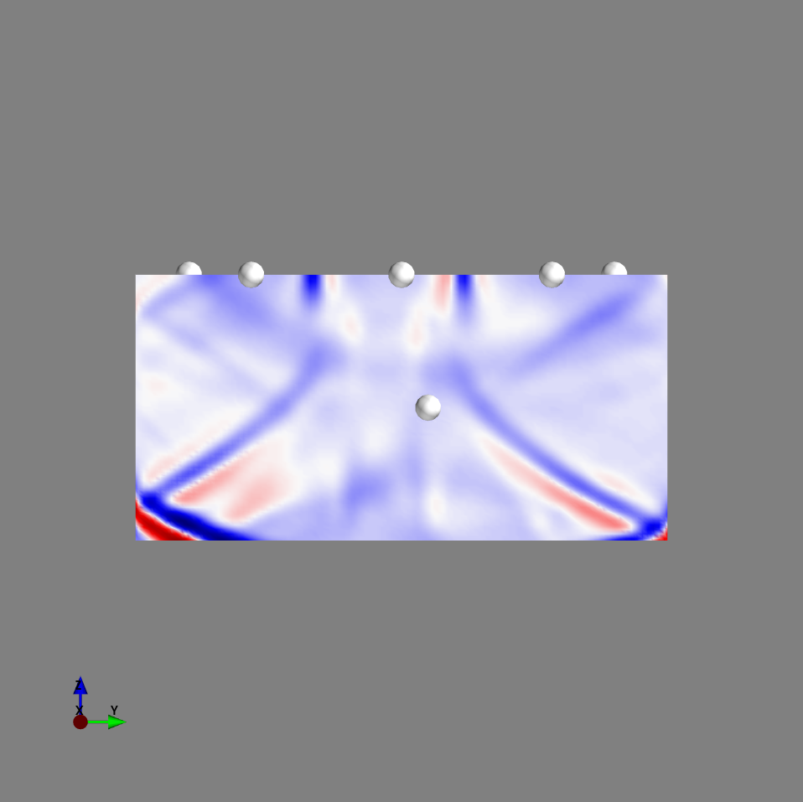
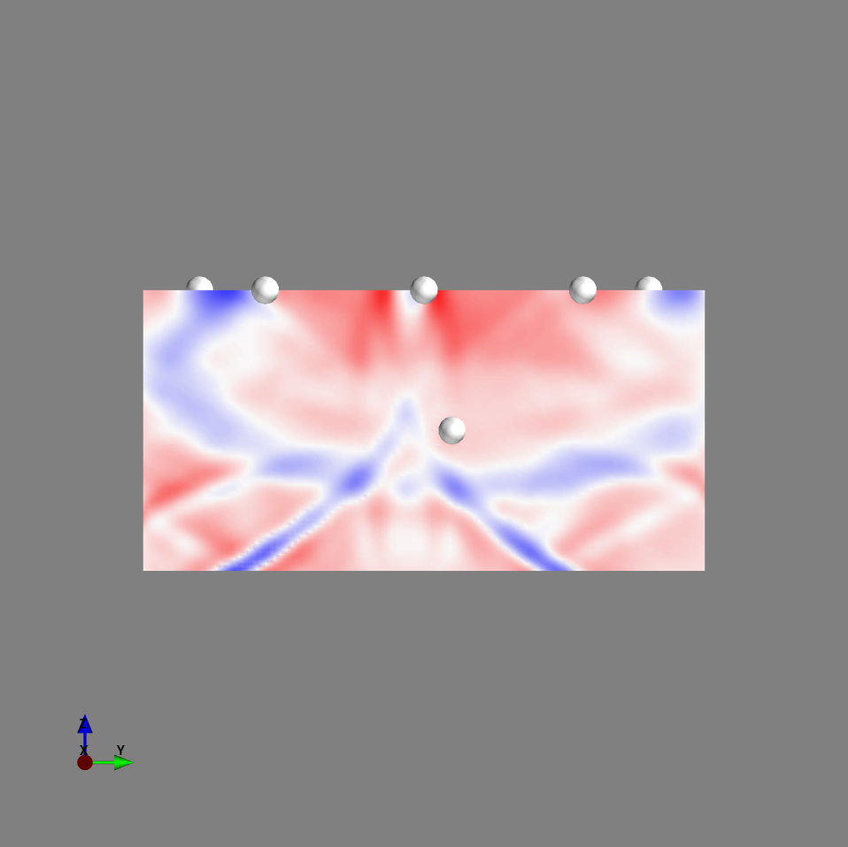
Movie volume (velocity Z component) slice at y=10 (+=red)
iteration100
iteration200
iteration300
iteration400
Reflected from free surface
iteration500
iteration600
iteration700

Slide 4
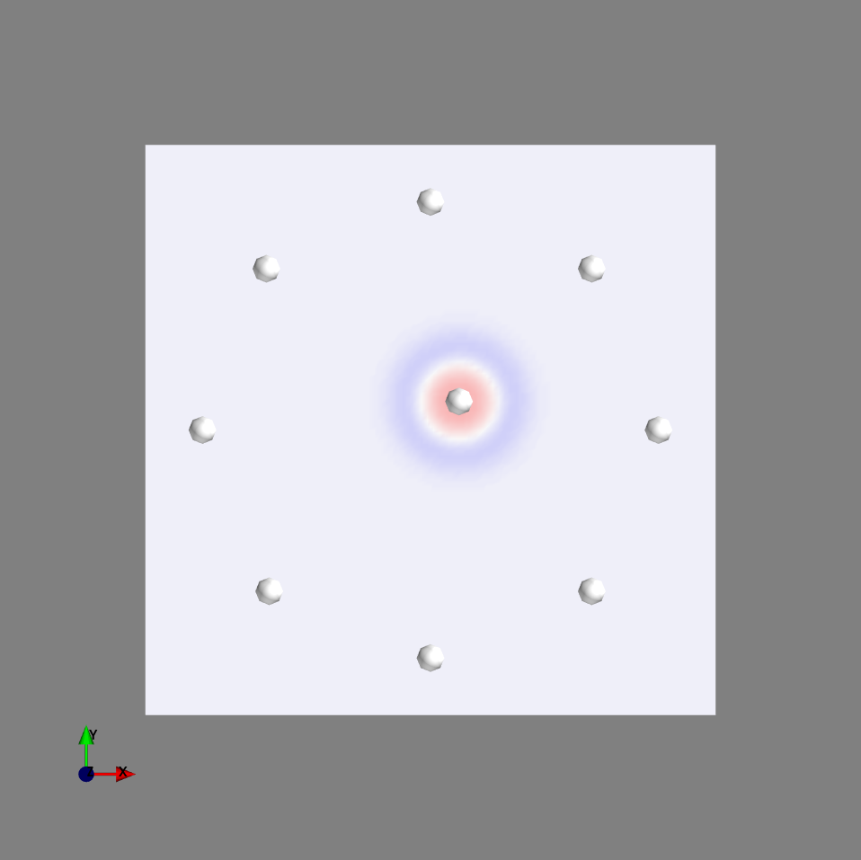
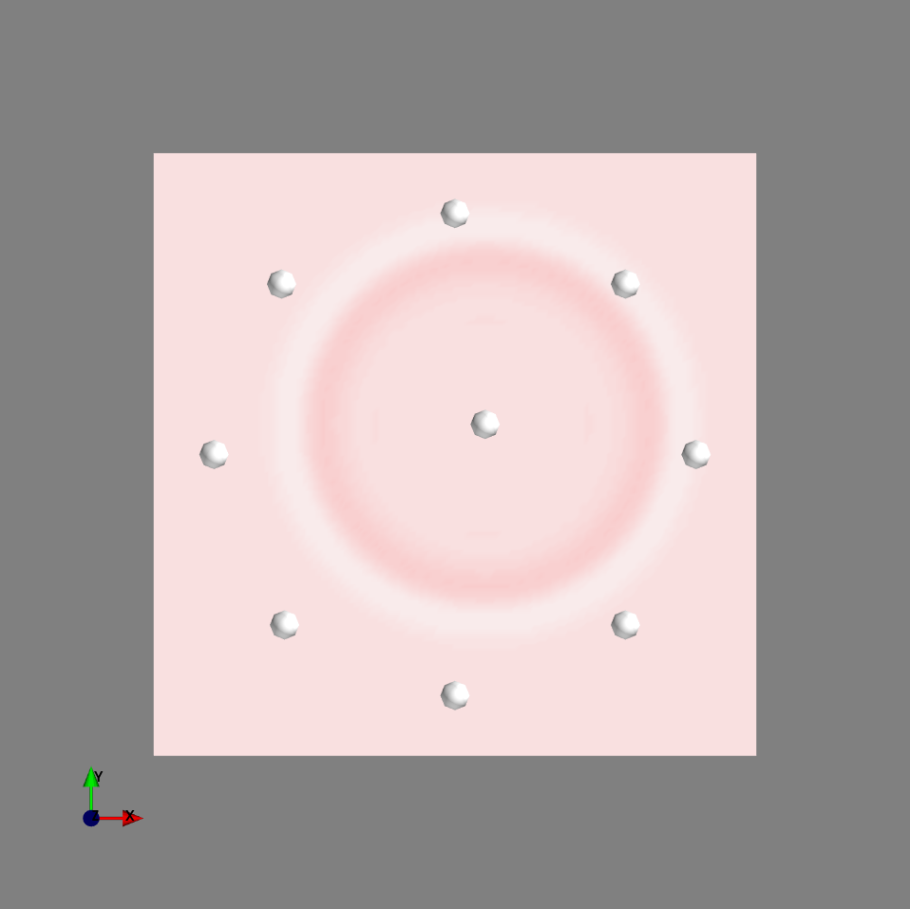
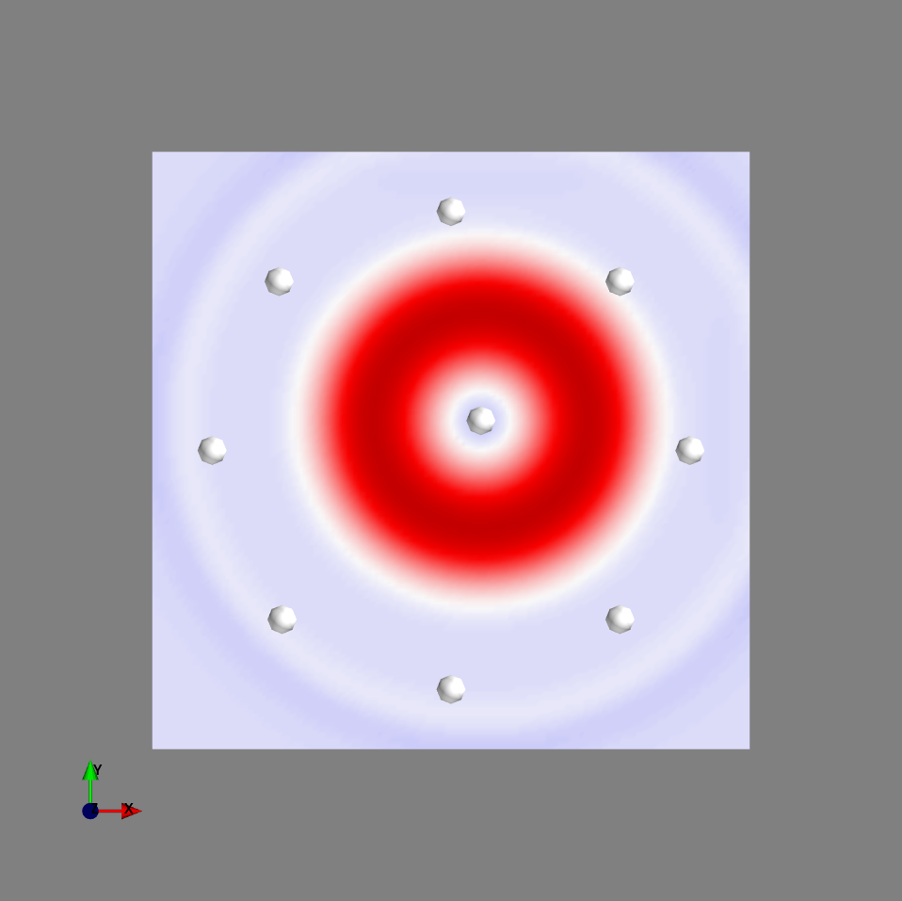
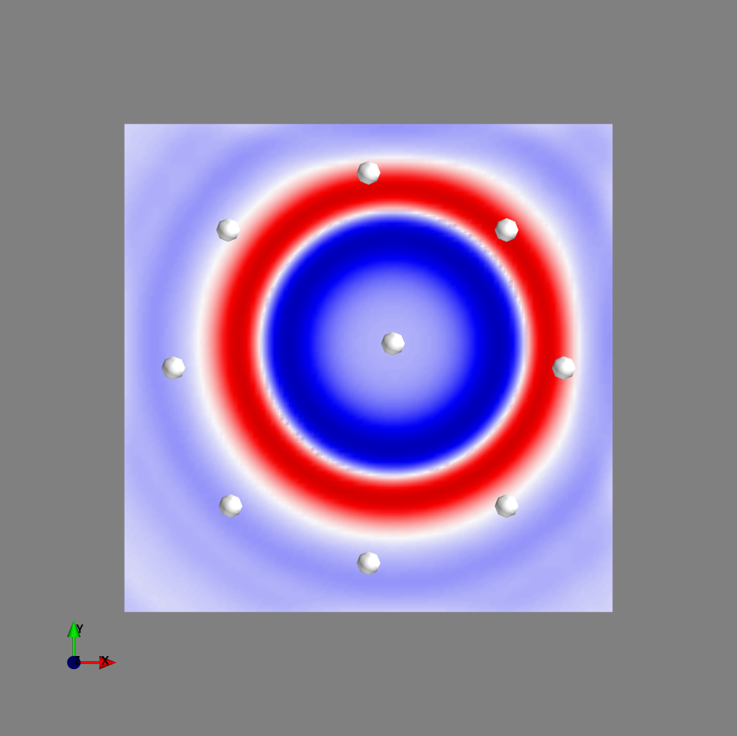
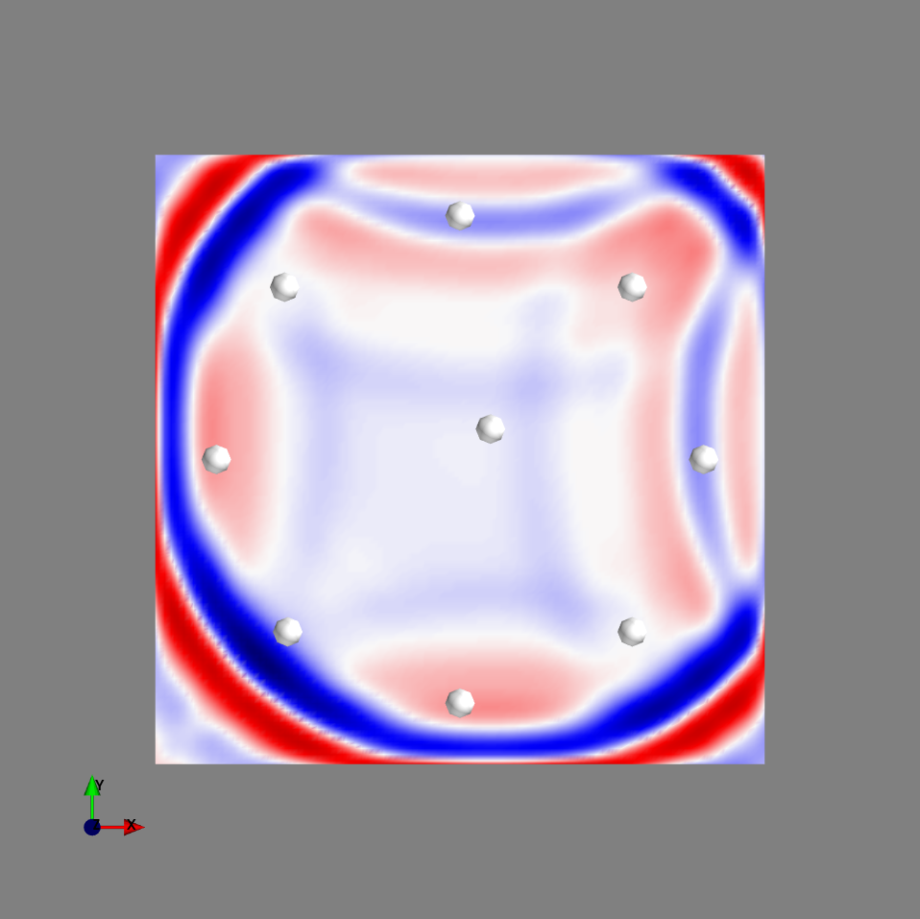
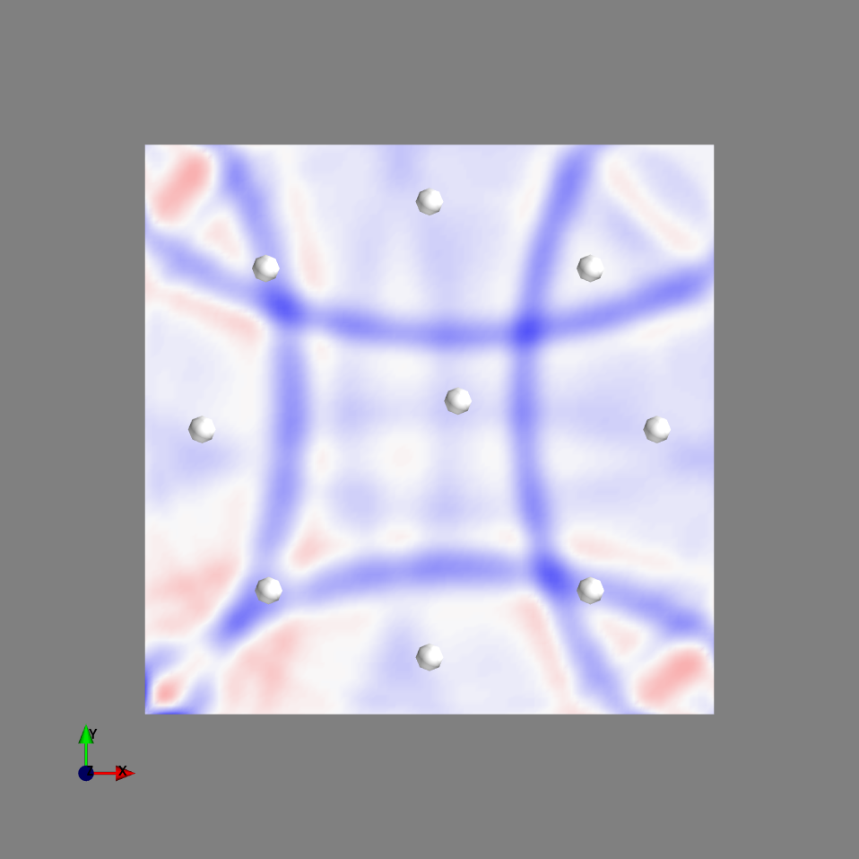
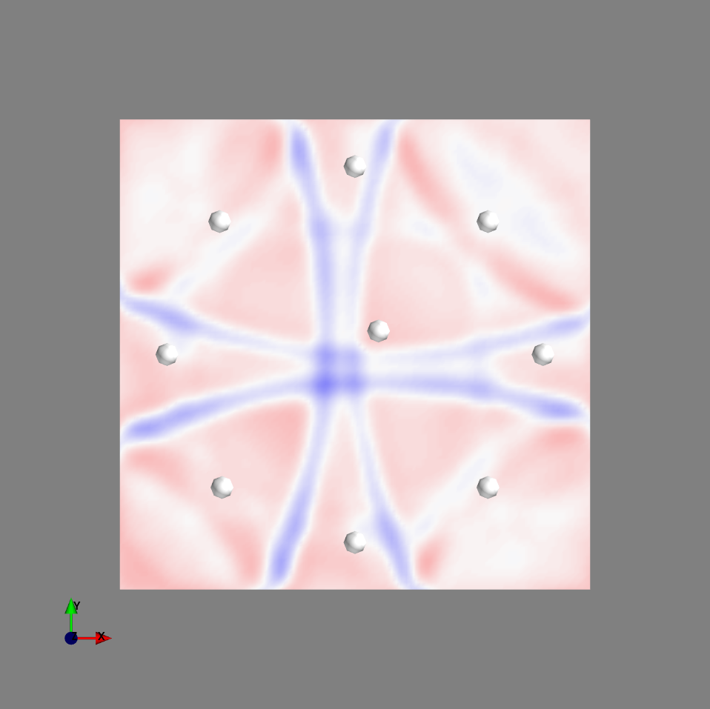
Movie volume (velocity Z comp.) slice at z = -50
iteration100
iteration200
iteration300
iteration400
iteration500
iteration600
iteration700

Slide 5
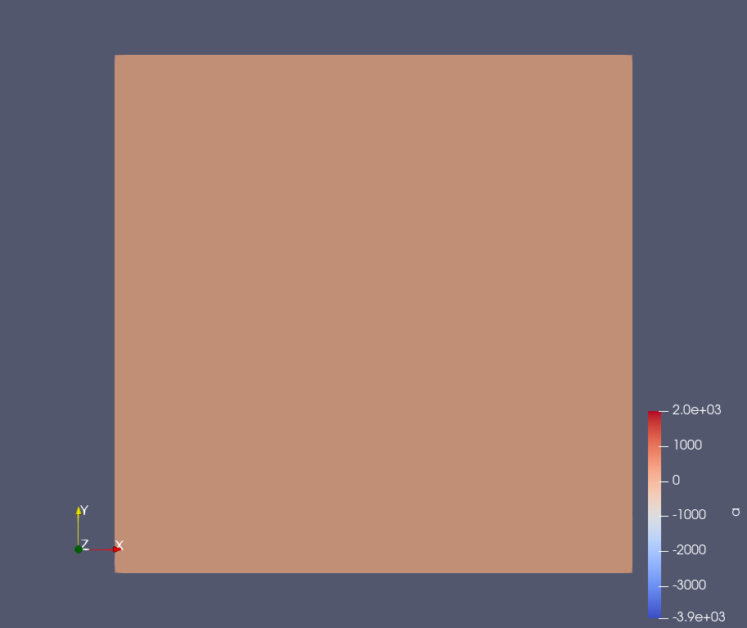
Surface Movie ( Velocity Z component at z=0)

Slide 6
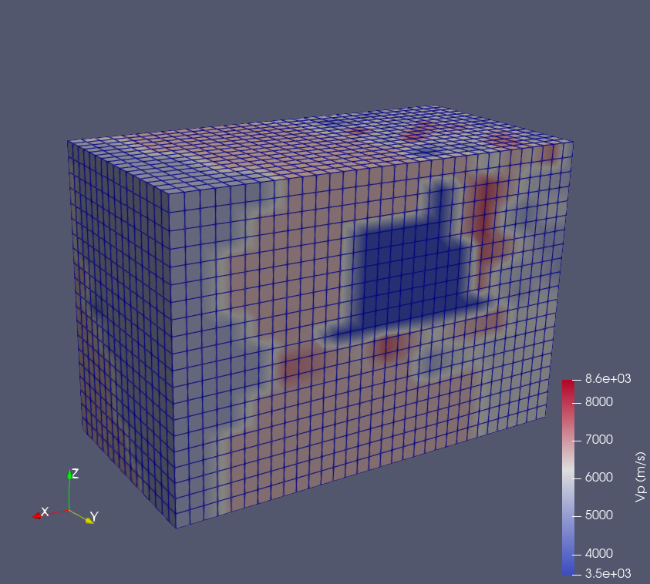
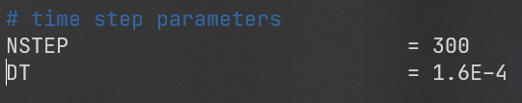
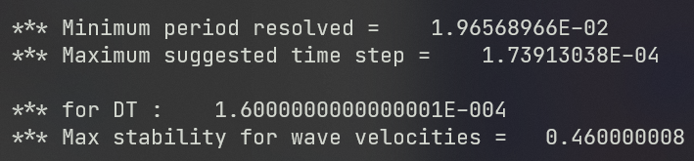
Tomographic model
We can supply tomographic model and assign vp, vs, density value to our mesh
Mesh configuration = mesh simple model
Source type = source type from simple model 2
Density calculated from Gardner’s equation

Slide 7
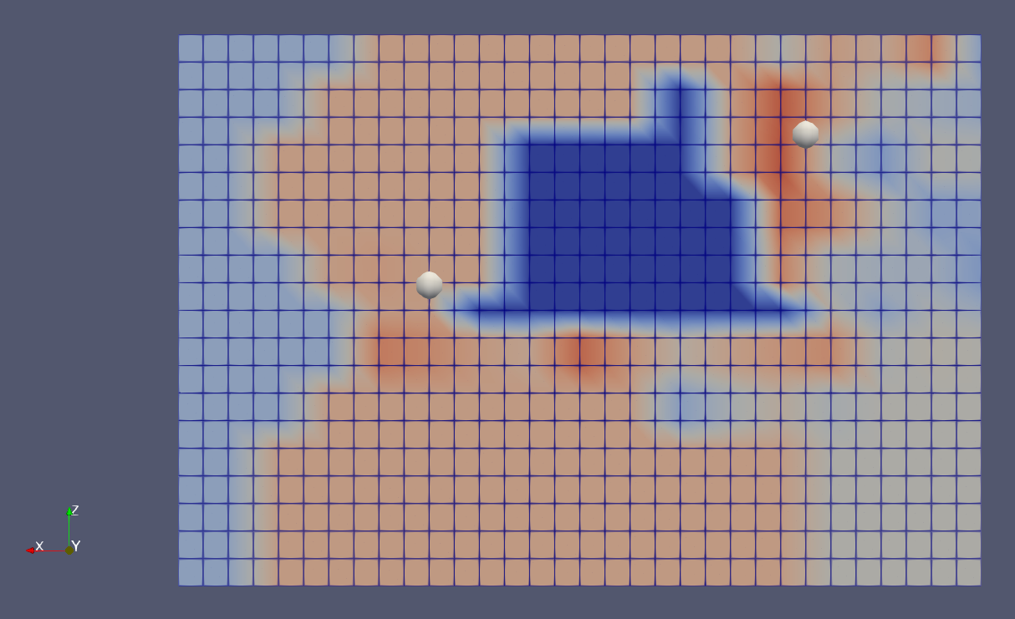
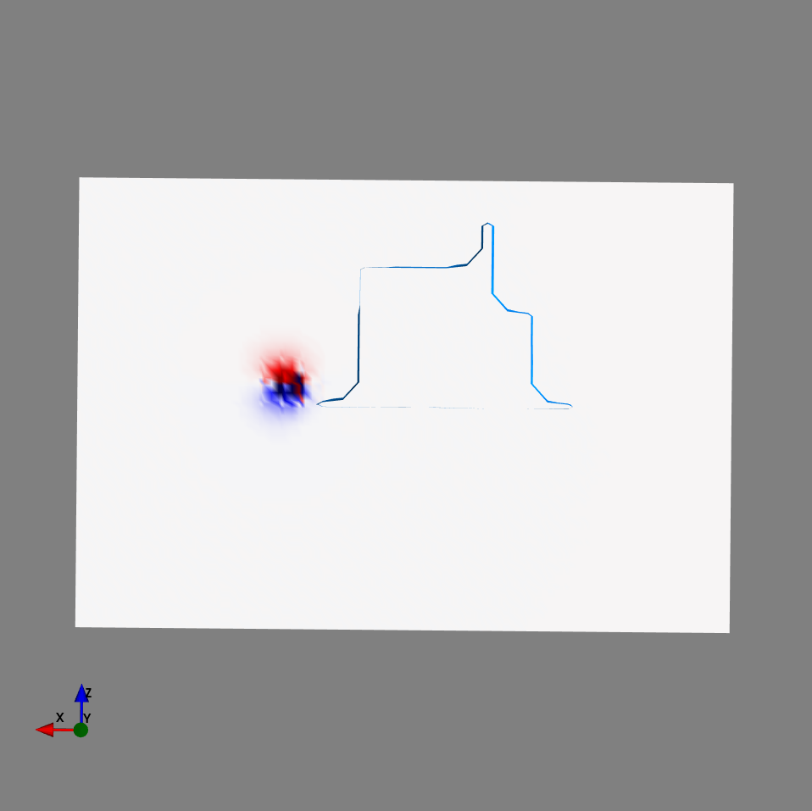
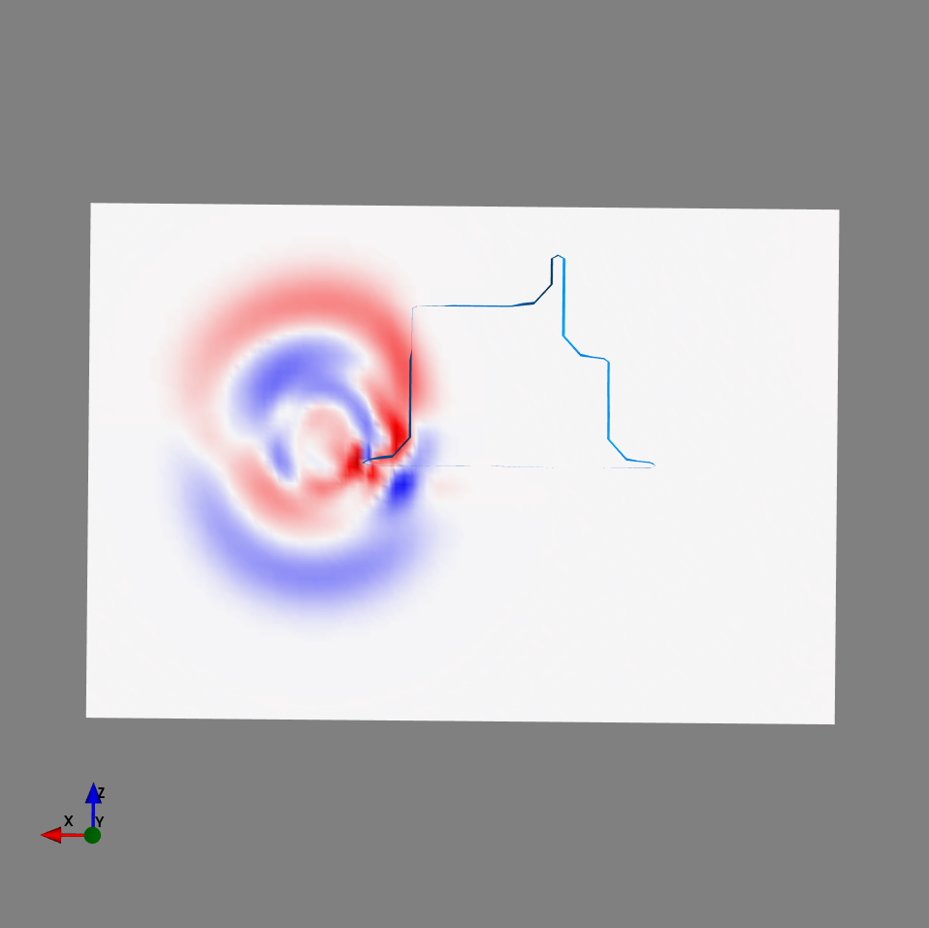
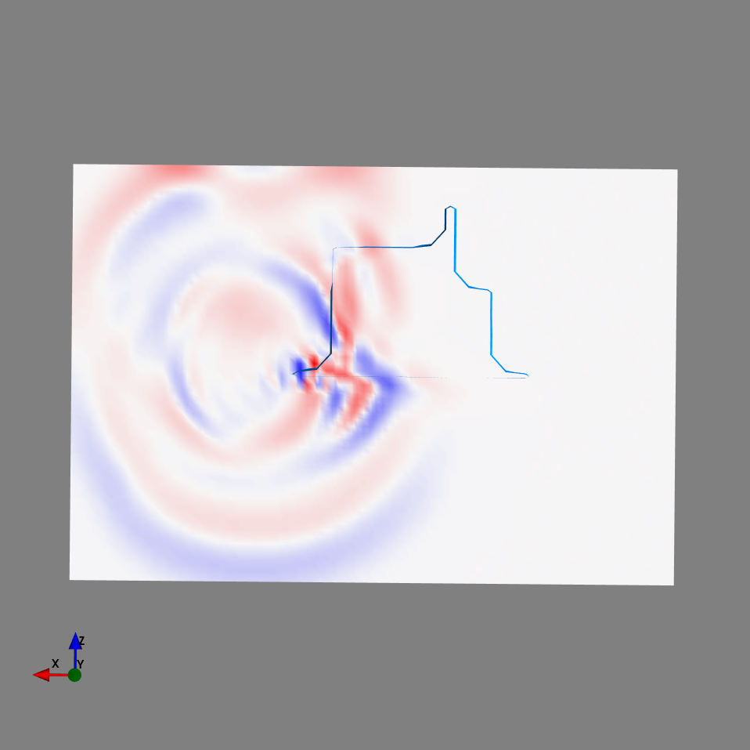
Movie
receiver
Source

Slide 8
Adjoint simulation

Slide 9
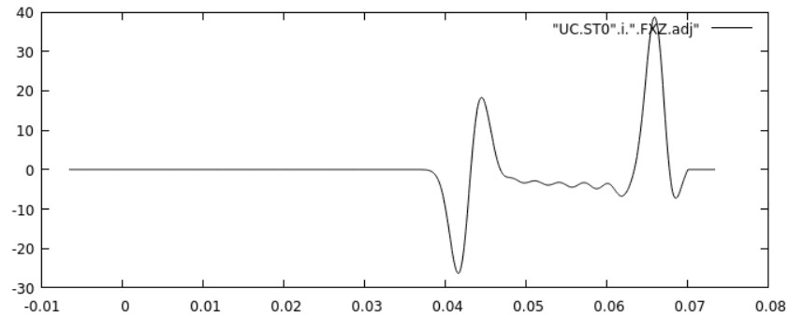
Adjoint simulation in a nutshell
Regular forward simulation
Solve wavefield
regular wavefield
Create seismic source
Adjoint simulation
Create adjoint source
Time-reverse the adjoint source
Solve wavefield (receiver as virtual source)
Adjoint wavefield

Slide 10
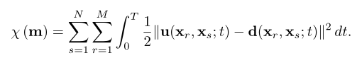
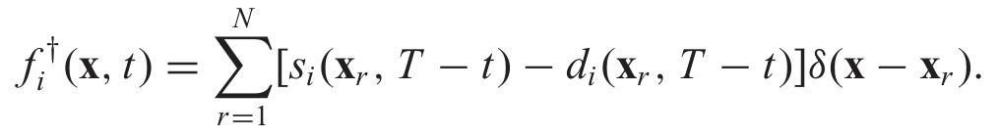
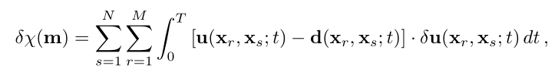
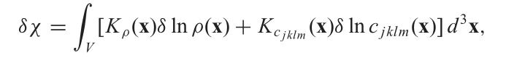
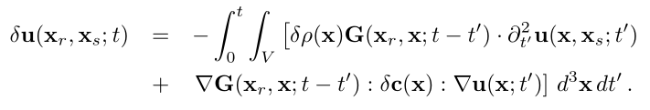
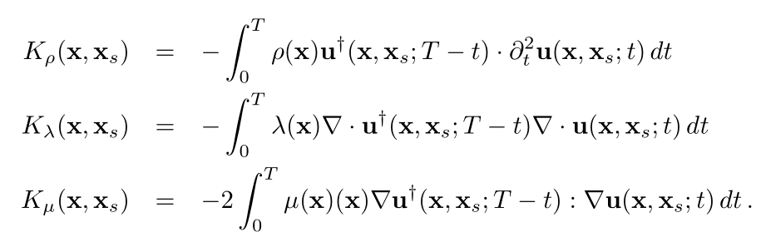
Waveform misfit adjoint source
Adjoint simulation -> tools untuk menghitung gradien dari misfit function

Slide 11
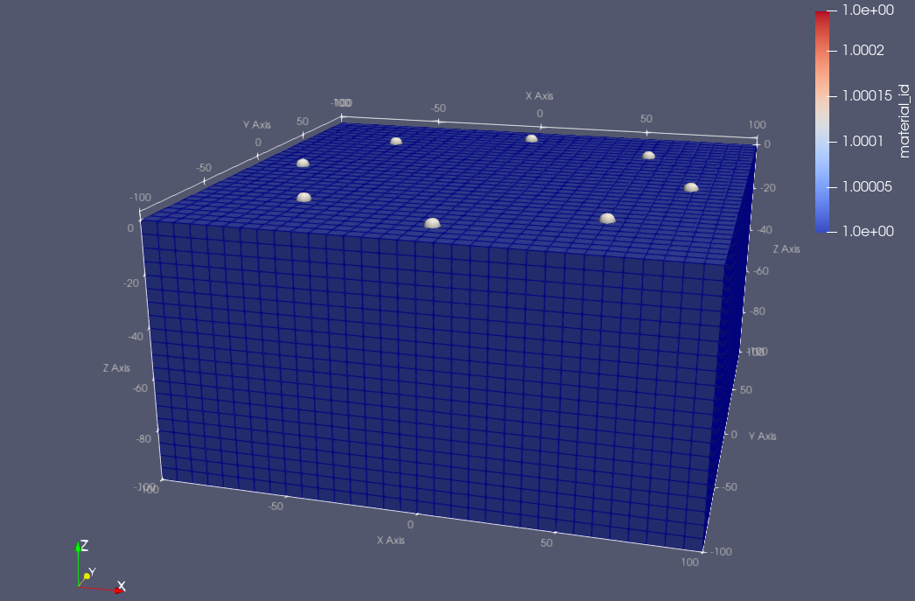
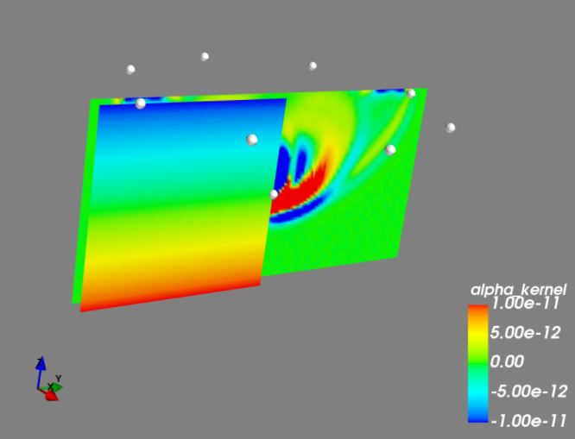
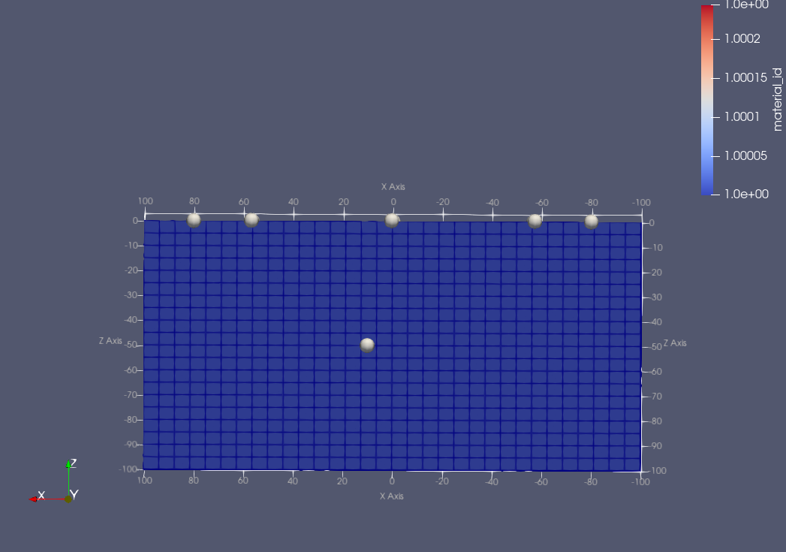
Model configuration (for synthetic and “data”)
Velocity for “DATA”
XMIN, XMAX = -100, 100 (in M)
YMIN, YMAX = -100, 100
ZMIN, ZMAX = -200, 0
N of elements in X direction = 32
N of elements in Y direction = 32
N of elements in Z direction = 20
Homogeneous
Vp = 2200 m/s
Vs = 1400 m/s
Density = 2200 kg/m³
Source

Slide 12
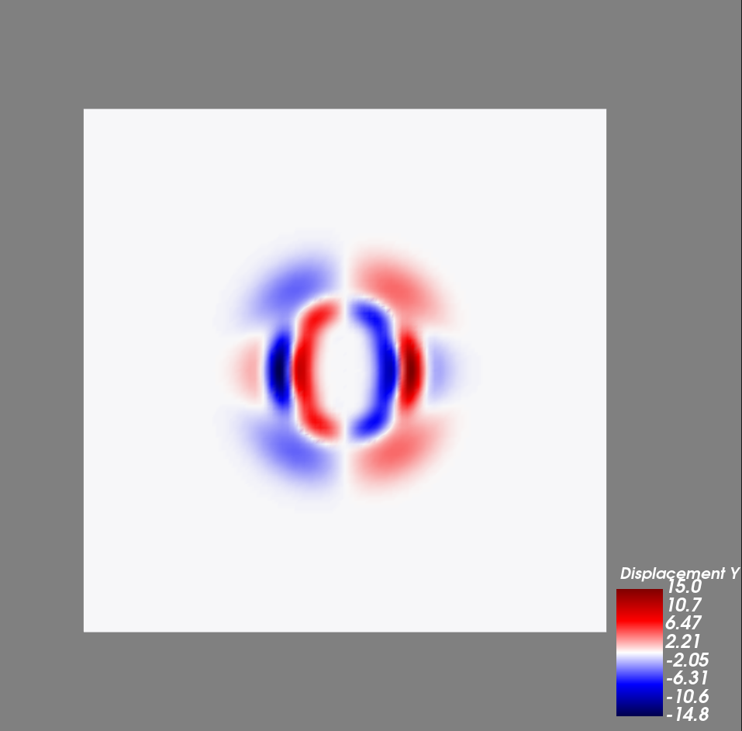
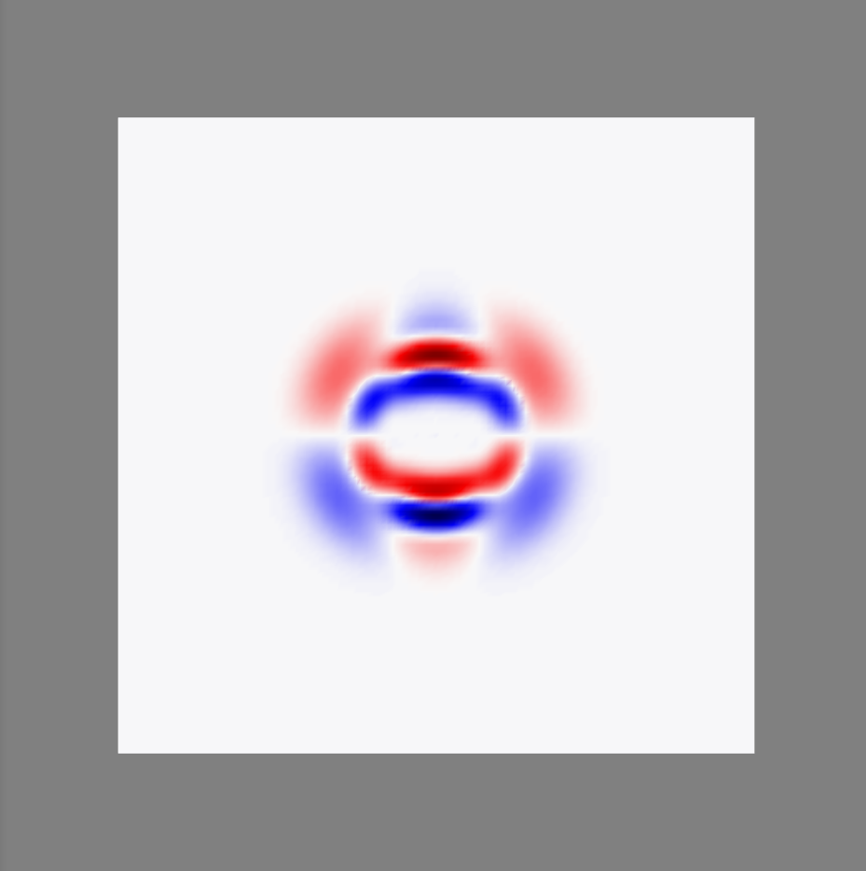
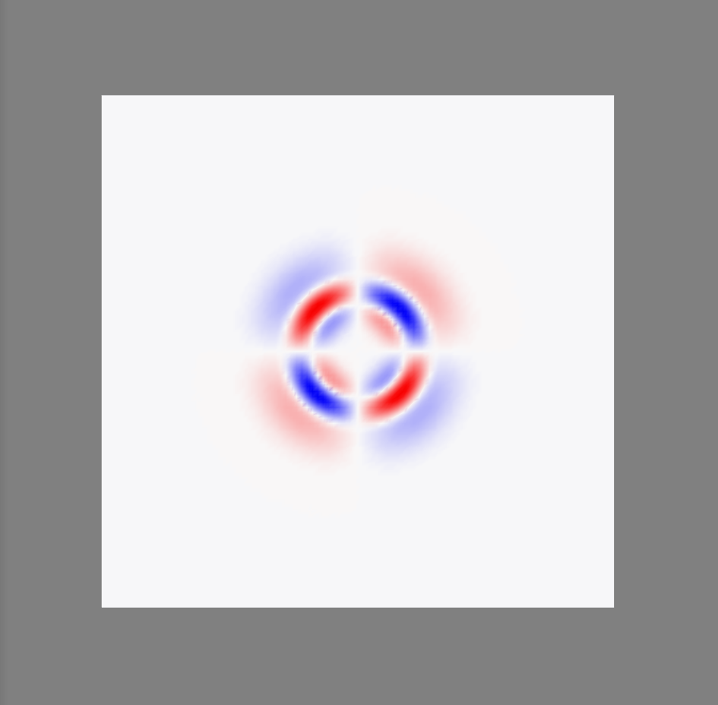

Simulation configuration
Source - DC

Slide 13
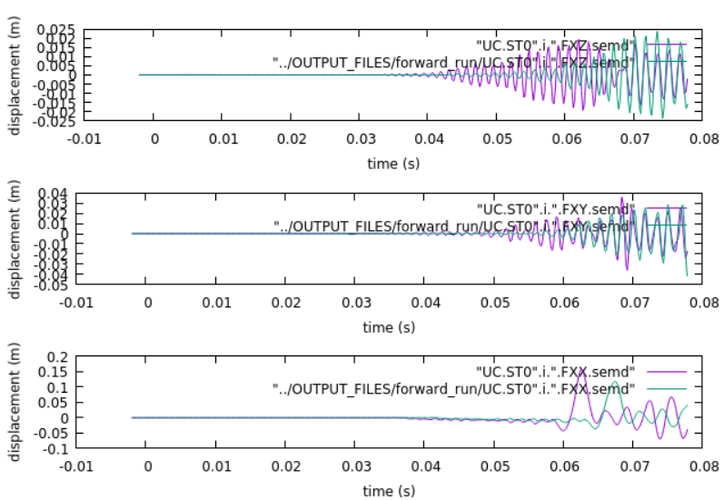
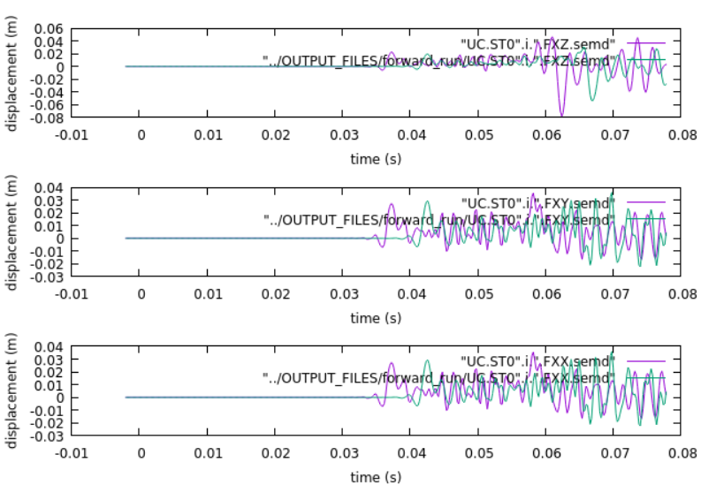
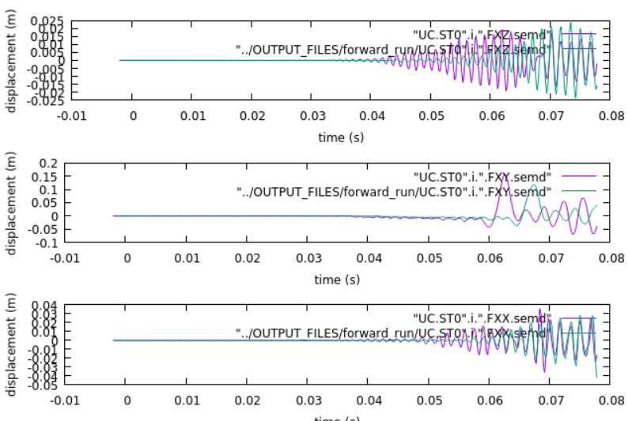
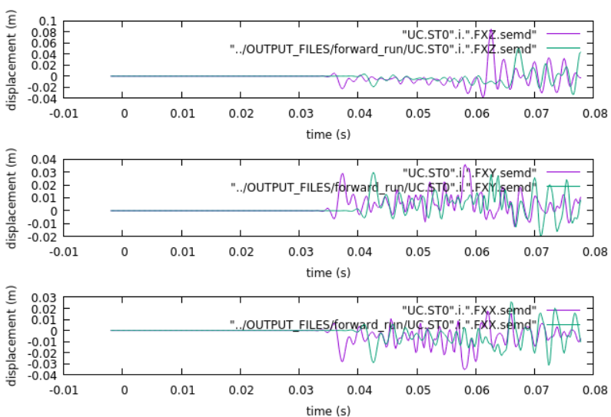

Slide 14
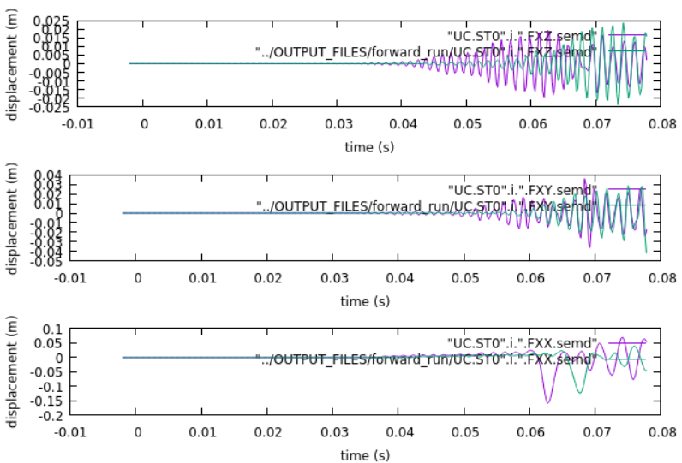
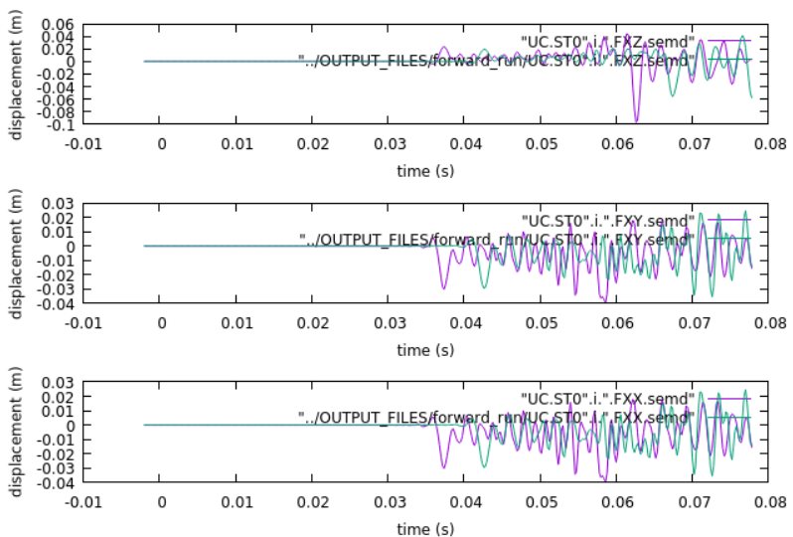
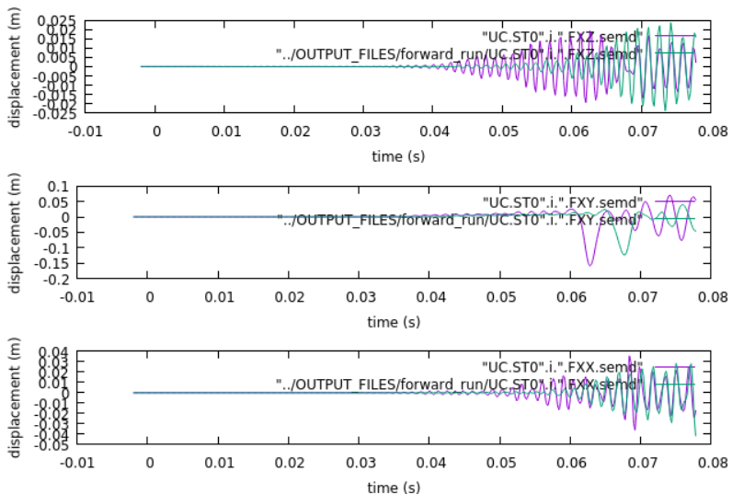
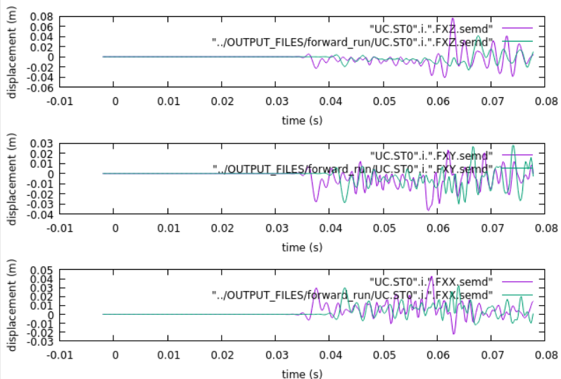

Slide 15
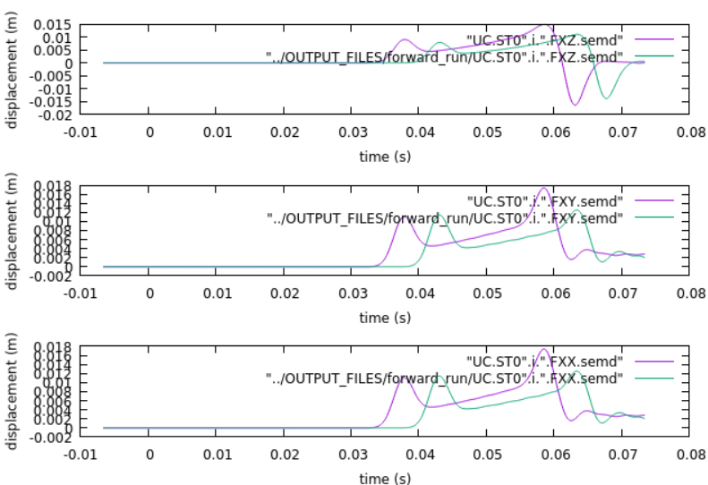
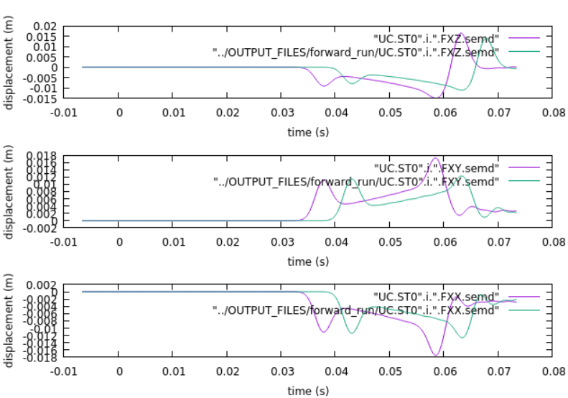
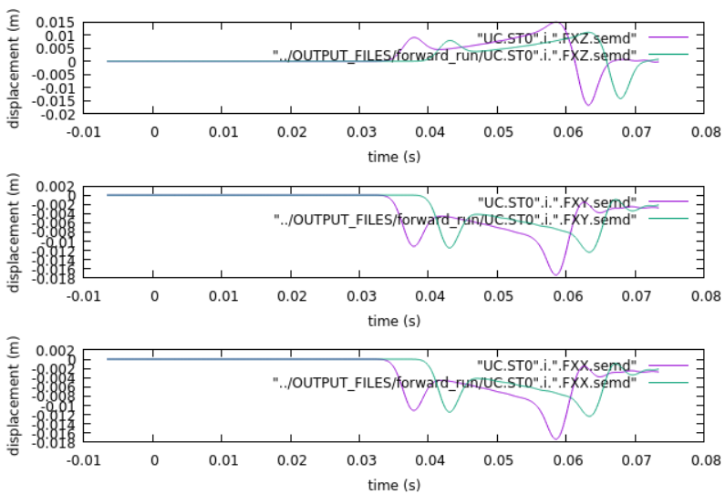
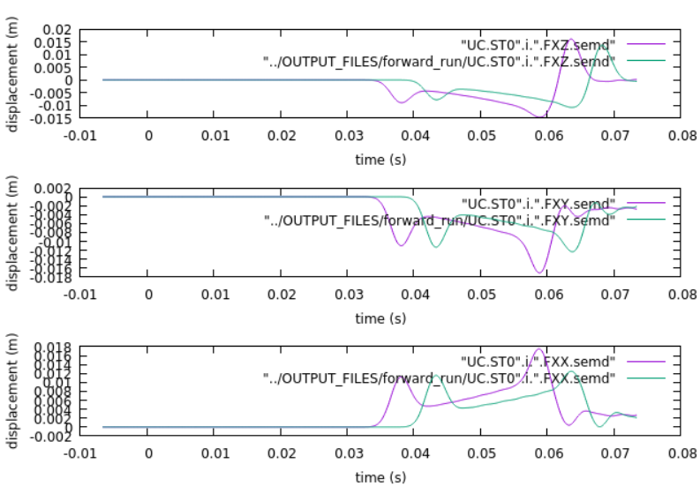

Slide 16
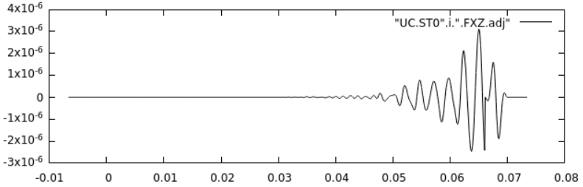
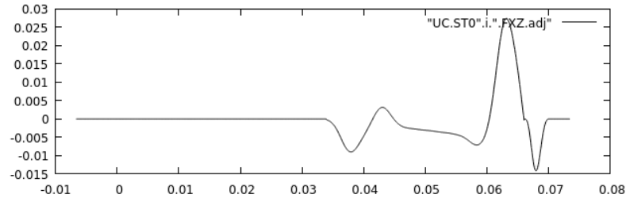

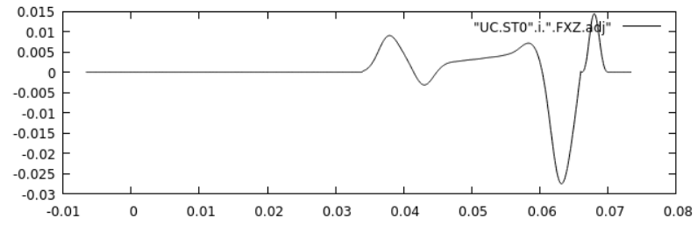





Slide 17



Derivatives with respect to structural parameter

Slide 18




Slide 19



Z = -50

Slide 20



Z = -25

Slide 21



Z = 0

Slide 22



Traveltime kernel

Slide 23




Slide 24





Slide 25



Traveltime kernel

Slide 26




Slide 27





Source Inversion (Derivative with respect to source parameters)

Slide 29

Adjoint source
Velocity = homogeneous
Data Moment Tensor = DC
Synthetic Moment Tensor = explosion

Slide 30








Slide 31


Slide 32





